Slide 1
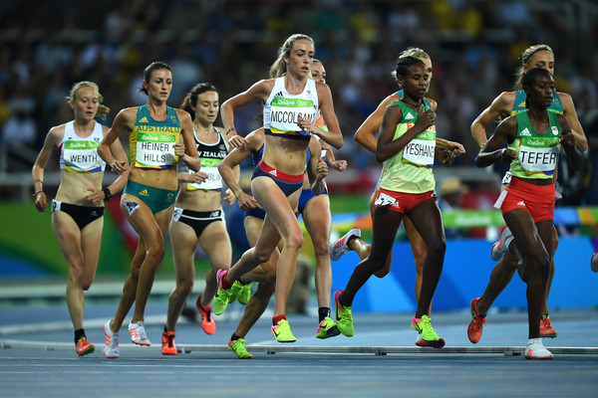
Eilish McColgan
Olympic 5,000m athlete

Slide 2
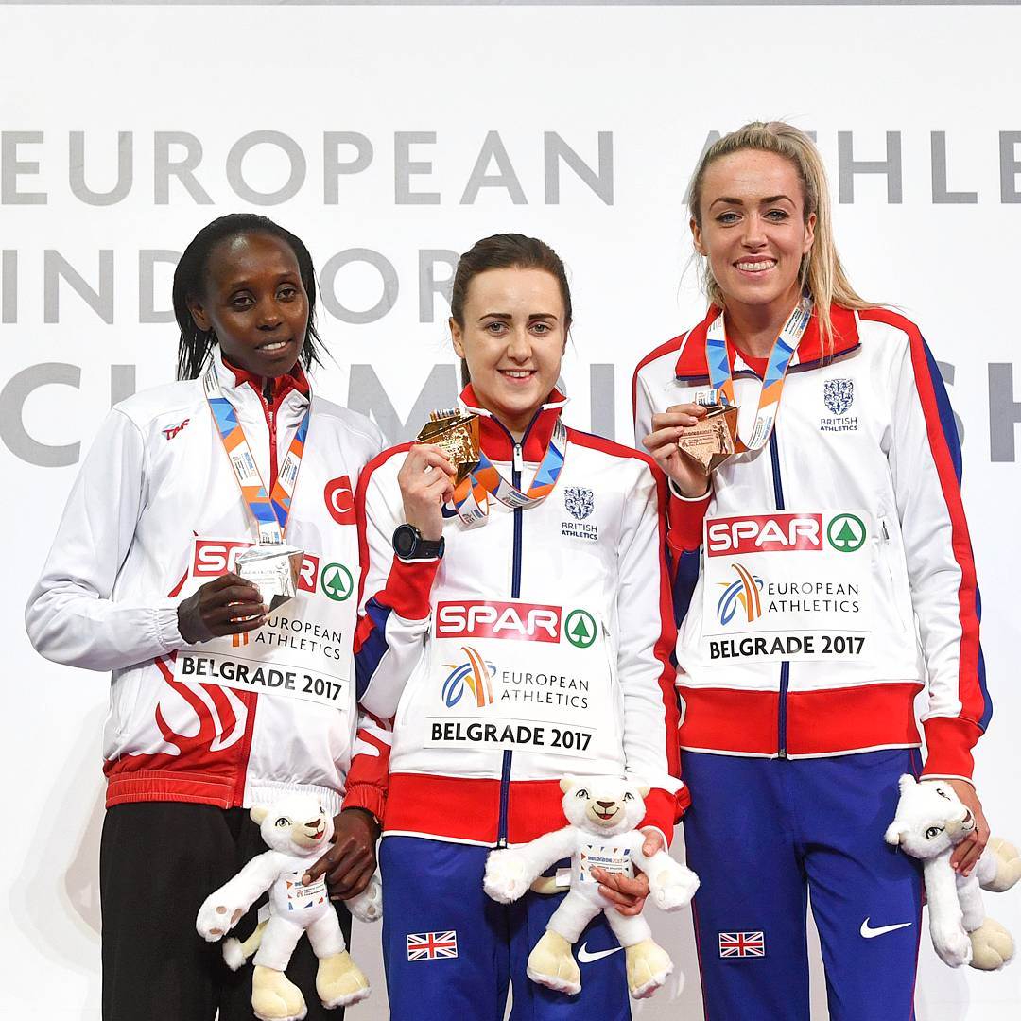
Double Olympian
Rio 2016, London 2012
Olympic & World Finalist
Scottish Record Holder
3 x British Champion
European Bronze Medallist
Double Olympian
Rio 2016, London 2012
Olympic & World Finalist
Scottish Record Holder
3 x British Champion
European Bronze Medallist

Slide 3
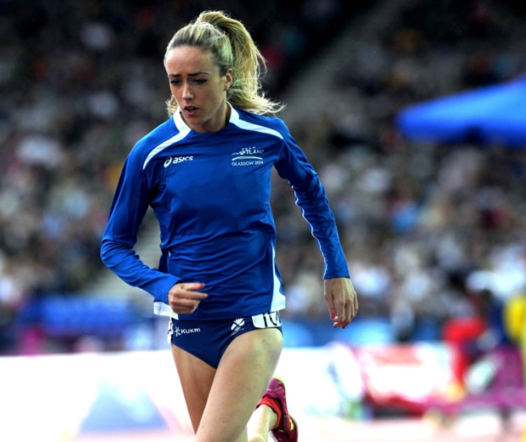
What is the 5,000m?
12 AND A HALF LAPS AROUND A TRACK.

Slide 4
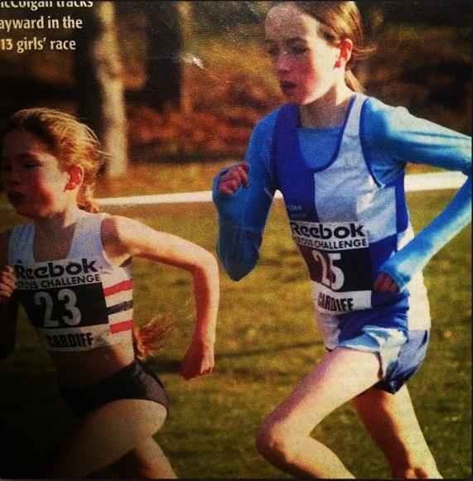
Where did it all begin?
Primary School Cross Country
Age 13, joined the Dundee Hawkhill Harriers.
Played loads of sports.
Started with the hurdles, javelin and high jump.

Slide 5
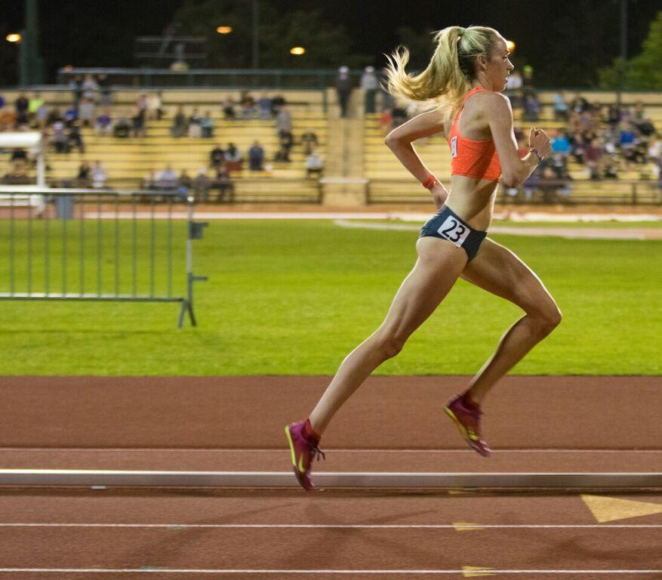
Resilience
What does it take to reach the top?
Determination
Hard training
Personal Best
Recovery
Positivity
Healthy Eating
Focus
Planning
Support
Effort

Slide 6
Top Tip Number 1

Slide 7
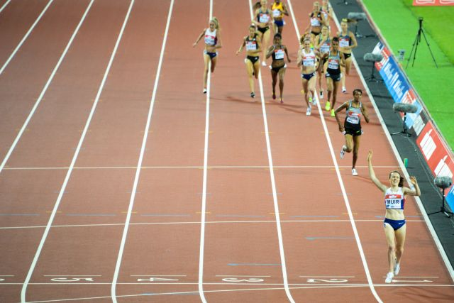
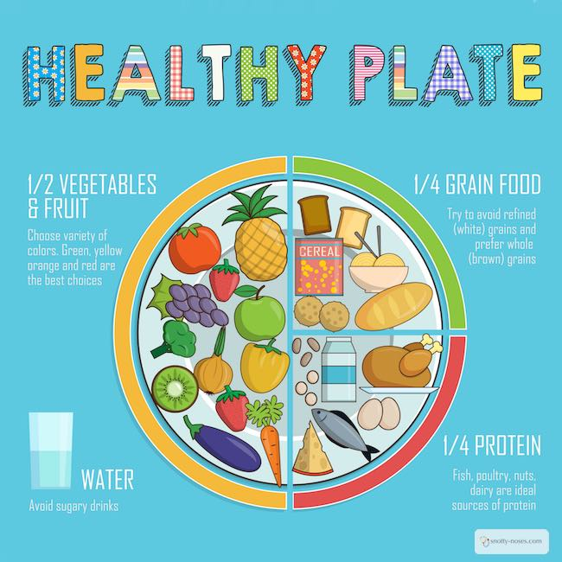

Slide 8
Top Tip Number 2

Slide 9
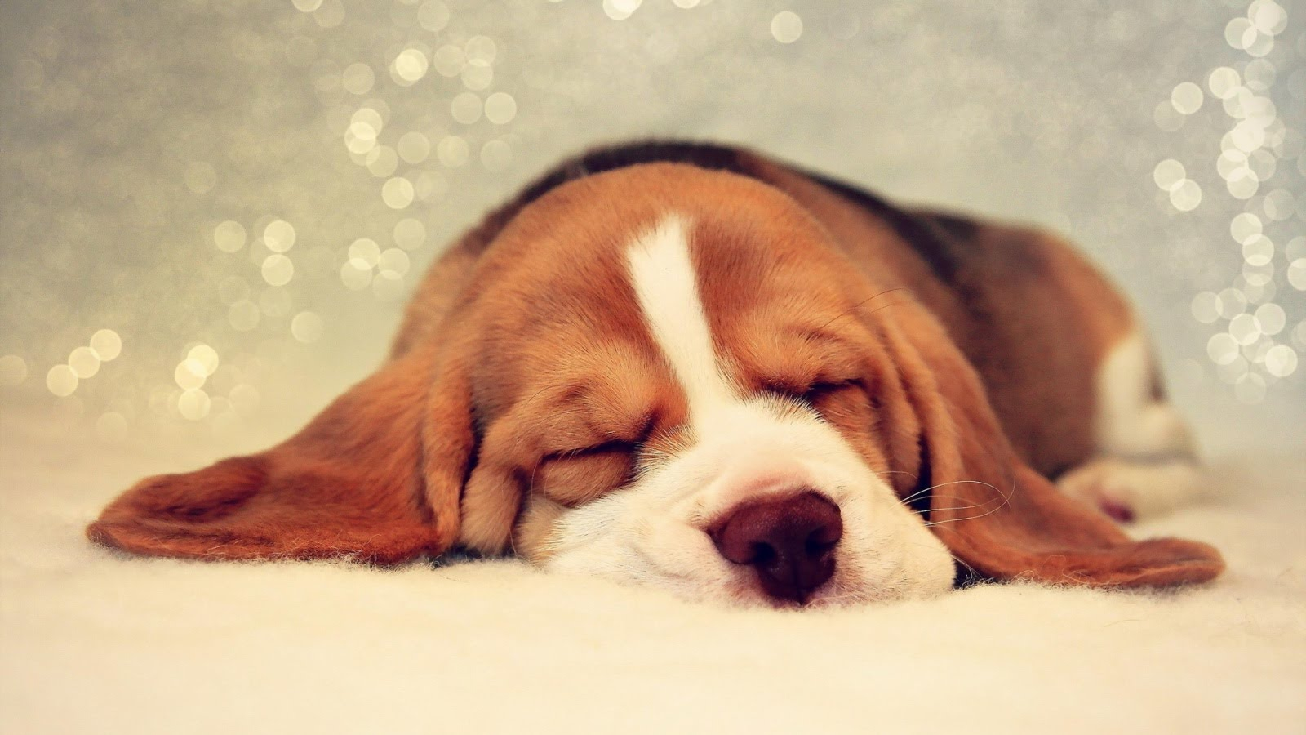
Rest and Recovery!
9 hours sleep every night!
1 hour nap when in hard training blocks!
Friday rest day!

Slide 10
Top Tip Number 3

Slide 11
Hard Work and Dedication
Training twice a day, 6 days a week.
Spending months away from home.
Sacrificing family birthdays and friends parties.

Slide 13
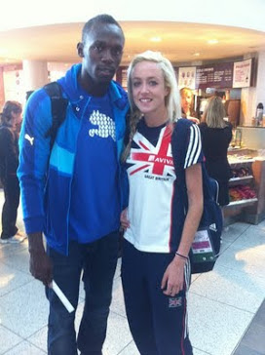
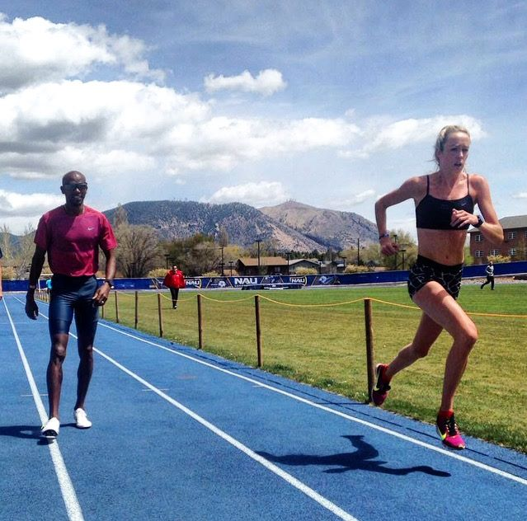
Meet loads of new people!
Ronny Reader

Slide 14

Brazil
India
France
USA
Kenya
Qatar
Japan
France
Spain
Russia
Czech Republic
Travel
The
World

Slide 15

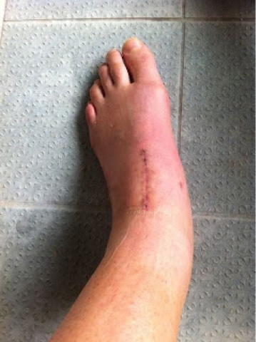
Injuries!
2011 - Broken Navicular
2015 - Broken Ankle
2 surgeries
7 screws and a metal plate

Slide 16
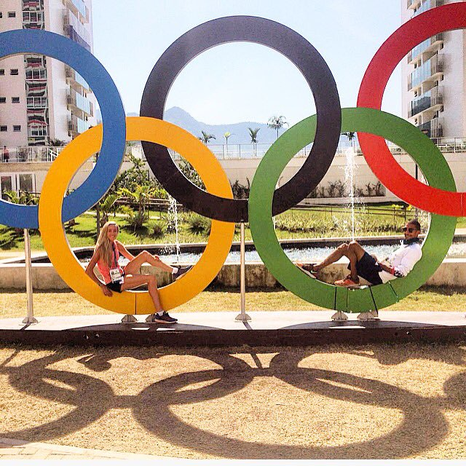
OVERCOMING FAILURE AND MISTAKES….
TO BECOME BETTER, FASTER AND STRONGER!

Slide 17
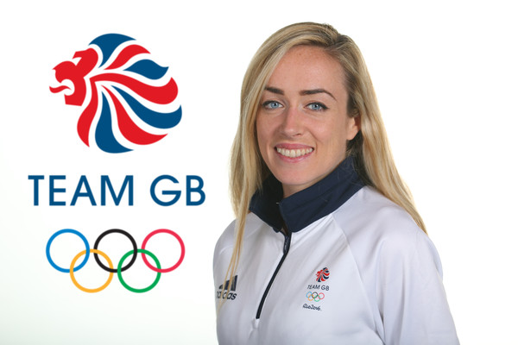
TIPS FOR THE TOP
Eat Healthily
Sleep/Recover
Dedication

Slide 18
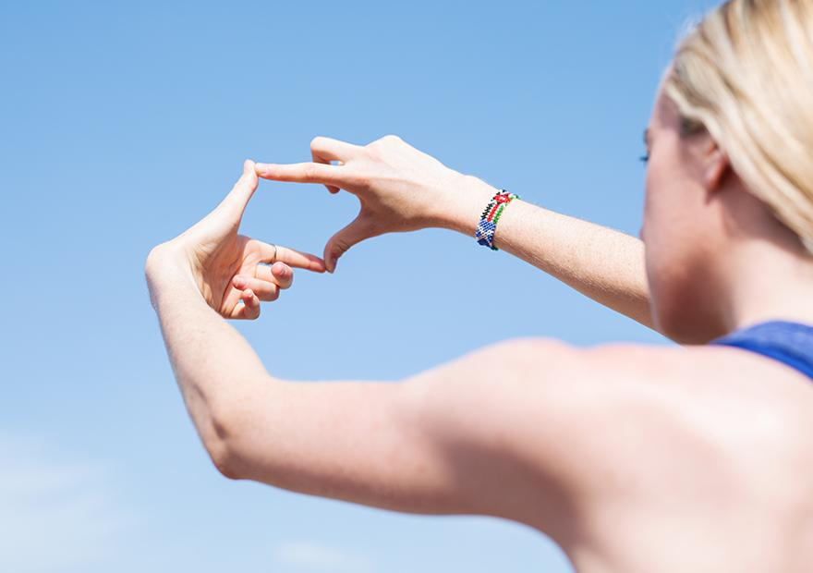
Dream
Big
&
NEVER
GIVE UP!

